Slide 1
IT Library
Project by:
Ajinkya
Harshavardhan
Luis
Syed shareq

Slide 2
Introduction
IT-Library is regarded as the brain of any institute, many institutes understand the importance of the library to the growth of the institute and their esteem users (students).
We have noticed the pain students take to learn a technology from various resources such as apps, tutorials research papers and different kinds of Reference Books.
IT-Library provides almost all information about a tech which is required to master a technical skill or subject.

Slide 3
Technologies used
Frontend:
Backend:
Bootstrap
HTML 5
CSS 3
Java Script
Adobe Dreamweaver
PHP
ORACLE(Data base)

Slide 4
Project Objective
To target Students, Developers , Designers, Engineers and to provide complete encyclopaedia of resources under one roof.
Provision for all kinds of learning media example apps, pdfs, books and video tutorials.
User can have tutors guiding them through issues faced which would be a paid option.
Tutors have an option to register themselves separately.

Slide 5
Target Users
Students
Software developers
It engineers
Professors
Beginners
Coders

Slide 6
Responsibilities
(1) Luis Arevalos
HTML and CSS design of
Homepage, Search, Browse contents
IT-Library Database Design
PHP programming for the global search
PHP programming for Hot Topics and New Courses on Homepage and footer.
(2) Harshvardhan shirole
– HTML and CSS design of
Global category, Categoty profiles
Research from different materials
PHP programming to work with categories
(3) Syed Shareq Ahmed
HTML and CSS design of
Log in, Sign up, About us
Create Database tables for login and users.
PHP programming to enable log in
(4) Ajinkya Gagare
HTML and CSS design of
Sitemap, Breadcrumbs, Contact us
PHP programming for breadcrumbs

Slide 7
Features:
User Login / Sign Up
Optimized Search Bar and Results
Site Map
Categories
Tutorial Directories
Trending Topics

Slide 9
Activities | Planning | Requirement gathering | Implementation and coding | Implementation and coding | Deployment | Deployment | Deployment | Deployment
Week 01
Week 02
Week 03
Week 04
Week 05 |  |  |  |  | First Milestone
Week 06
Week 07 |  |  |  |  |  |  | Second Milestone
Week 08
Week 09
Week 10

Slide 10
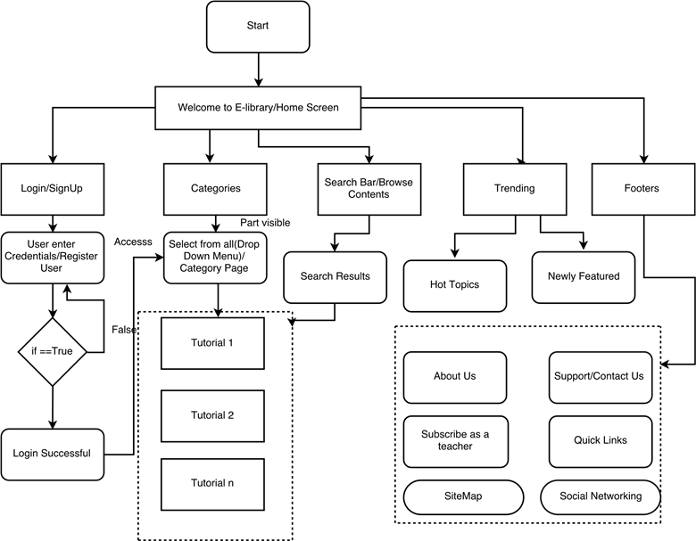
Site Diagram (Blueprint)

Slide 11
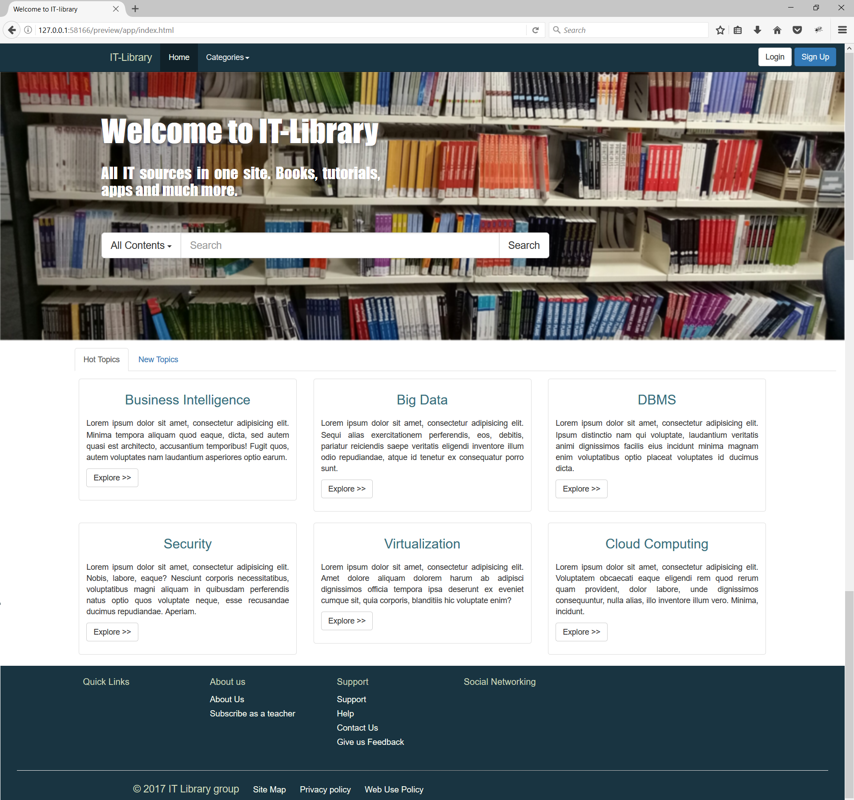
Welcome Page:

Slide 12
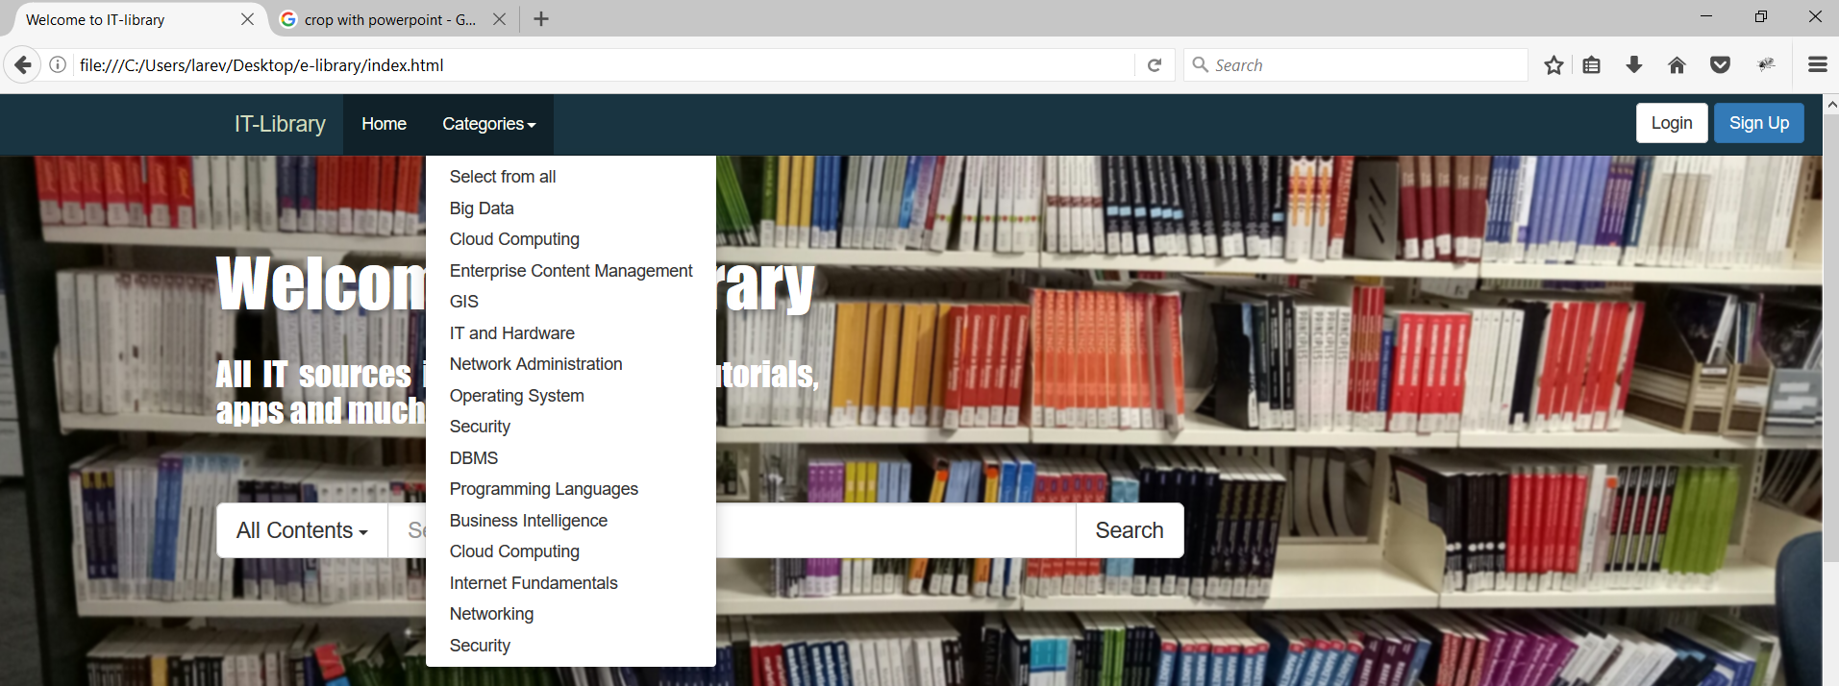
Navbar:
Notes:
Final user can navigate each category to finding a resource, that can be tutorials, books, apps, research, .

Slide 13
Search:
Notes:
Final user can navigate each category to finding a resource, that can be tutorials, books, apps, research, .
They will search by default trhout all contents, all categories

Slide 14
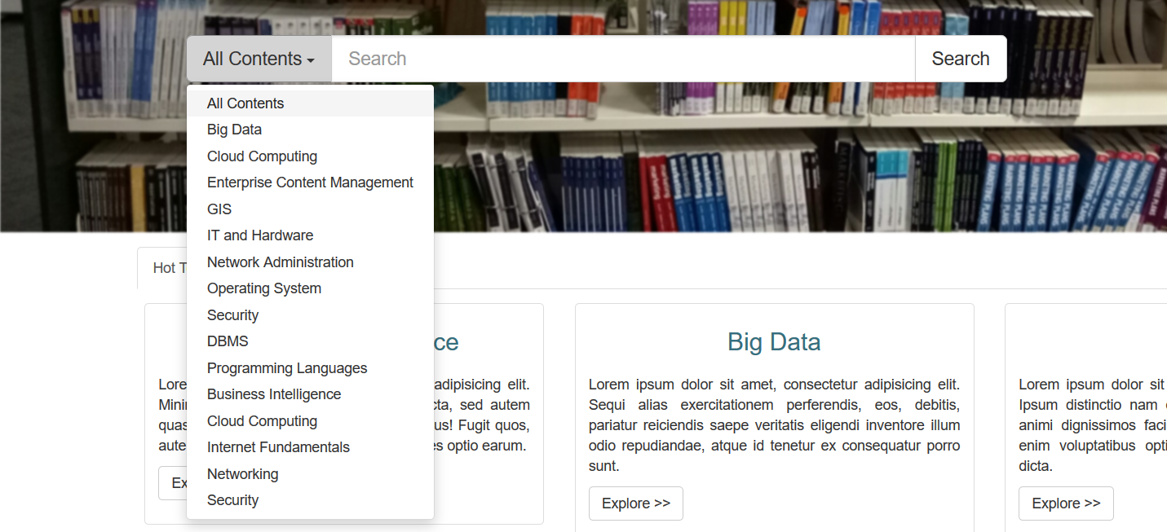
Search:
Notes:
But the final user can select inside which specifically category they want to search

Slide 15
Hot Topics:
Notes:
We also have the hot topic section, in which we show the trending categories.
So we add a quick access

Slide 16

New Topics:
Notes:
The new courses that we add in the database

Slide 17
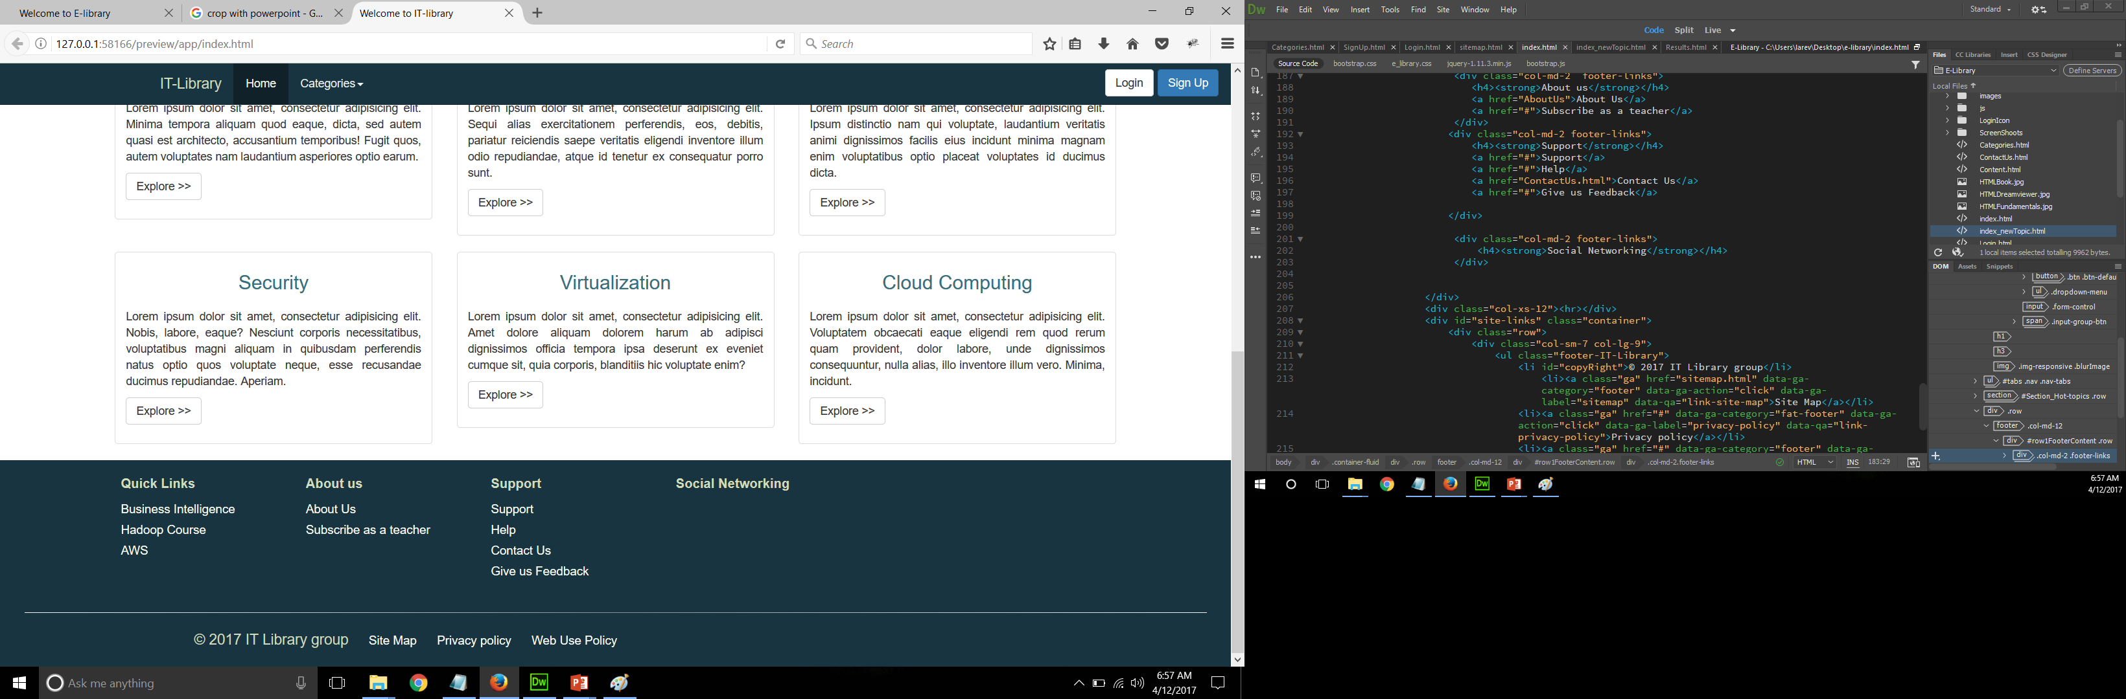
Footer:
Notes:
The new courses that we add in the database
We have the structure for social networking

Slide 18
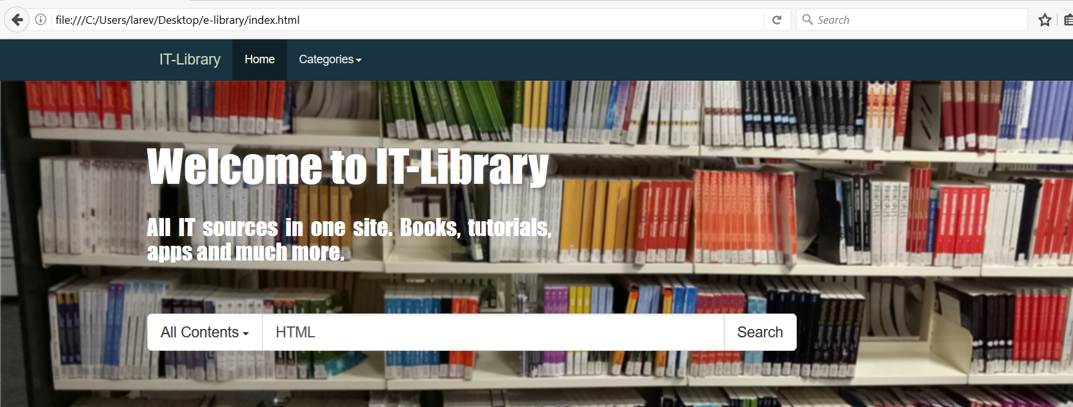
Search:
Notes:
But the final user can select inside which specifically category they want to search

Slide 19
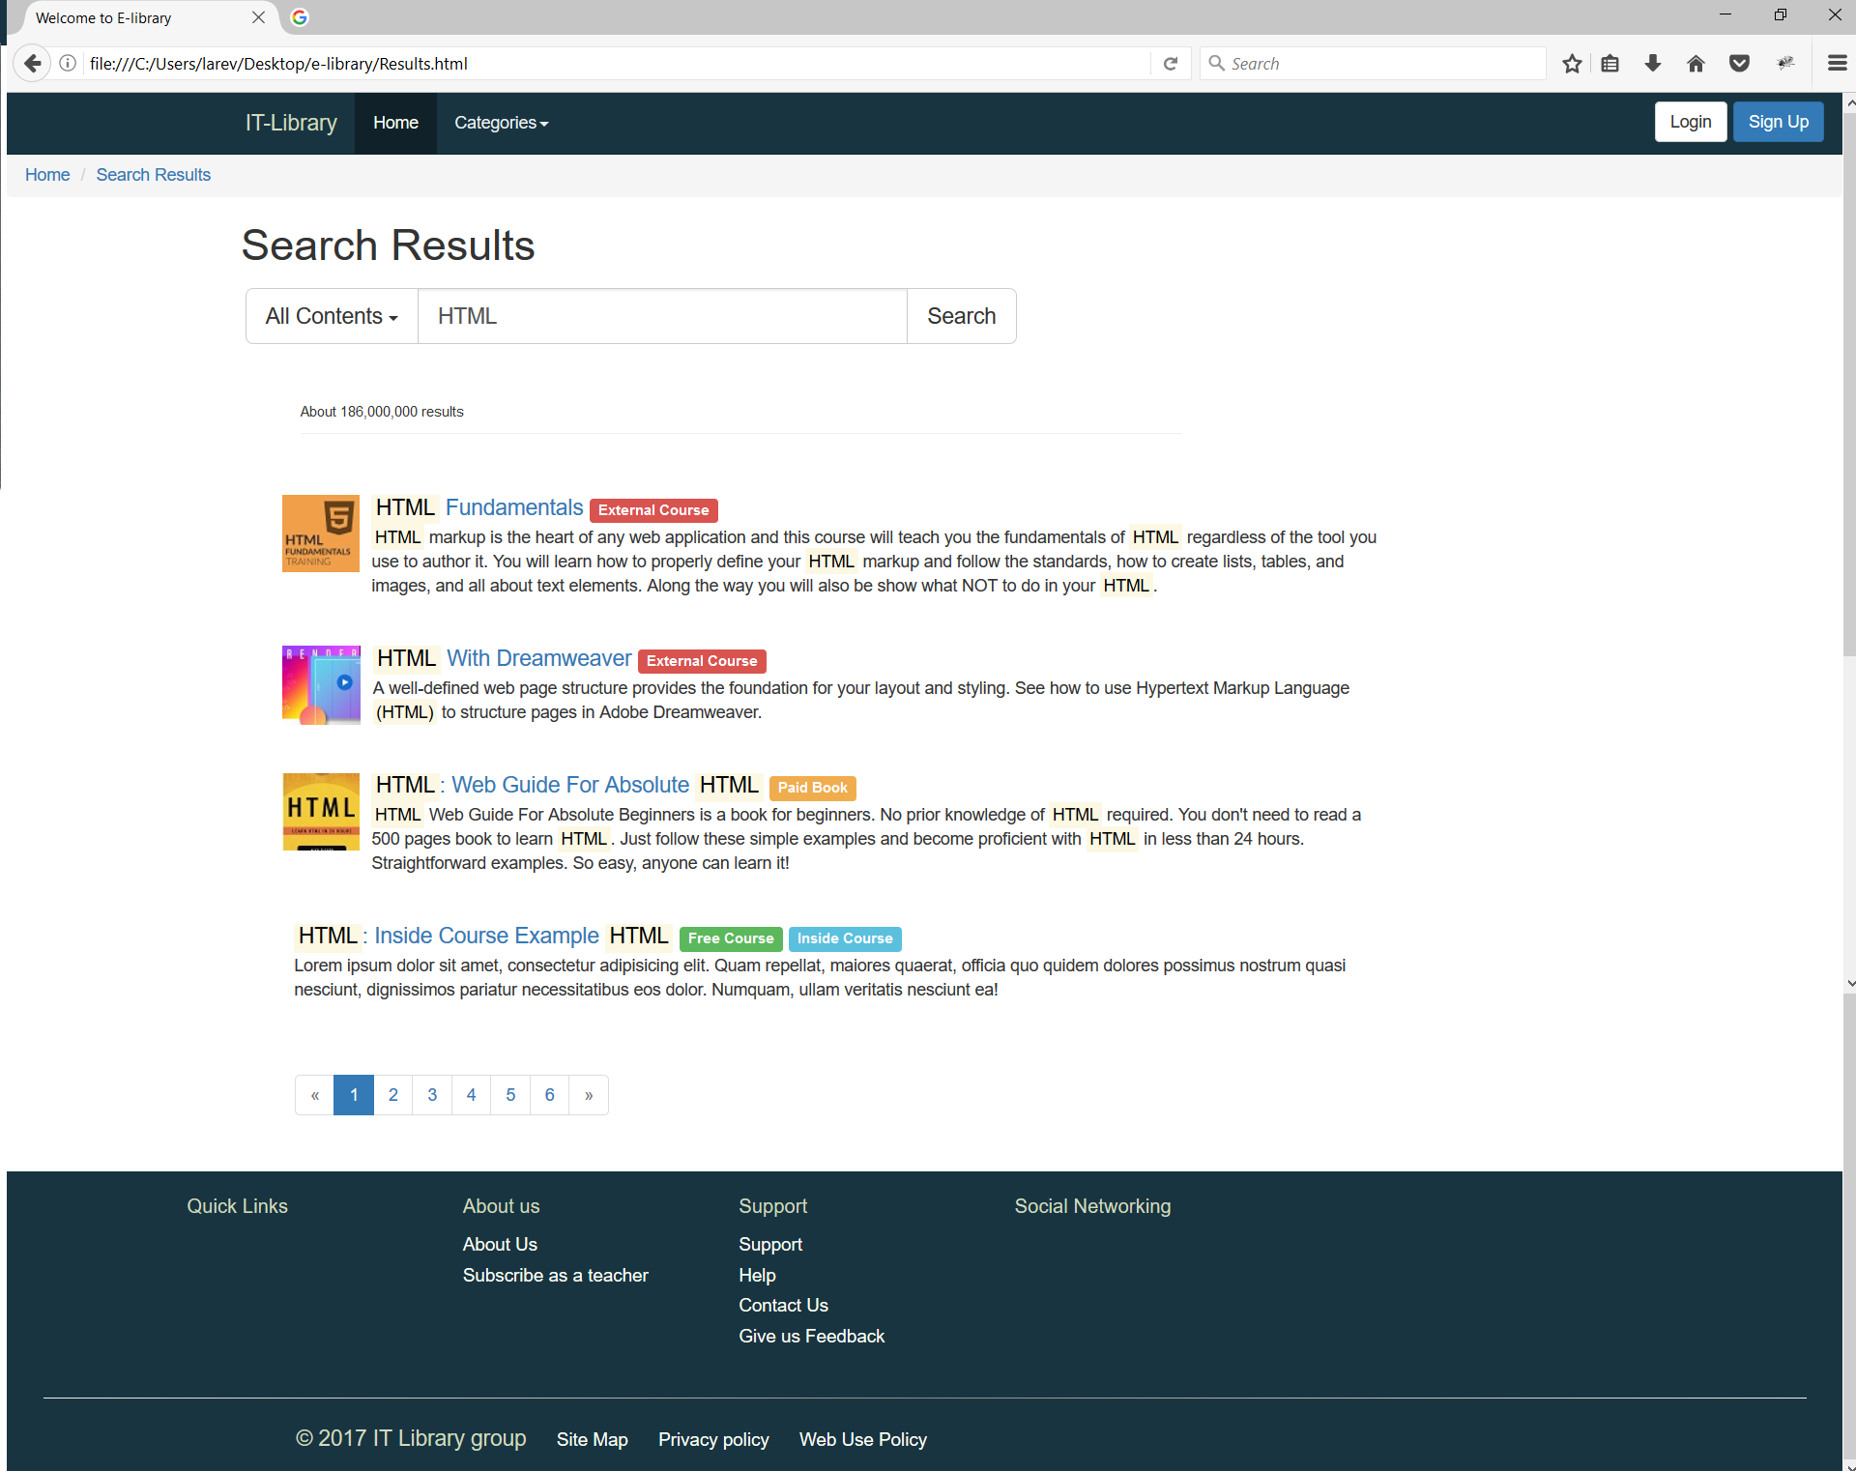
Search:
Notes:
But the final user can select inside which specifically category they want to search

Slide 20
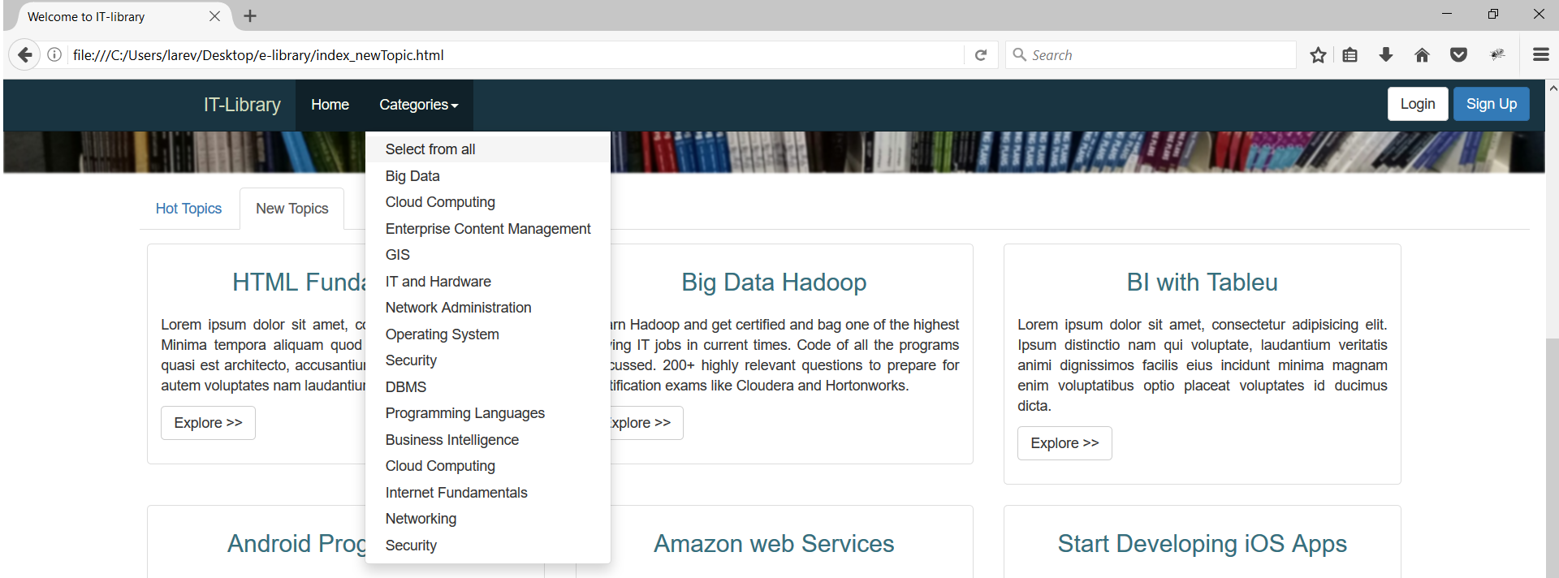
Drop down Category Navigation:

Slide 21
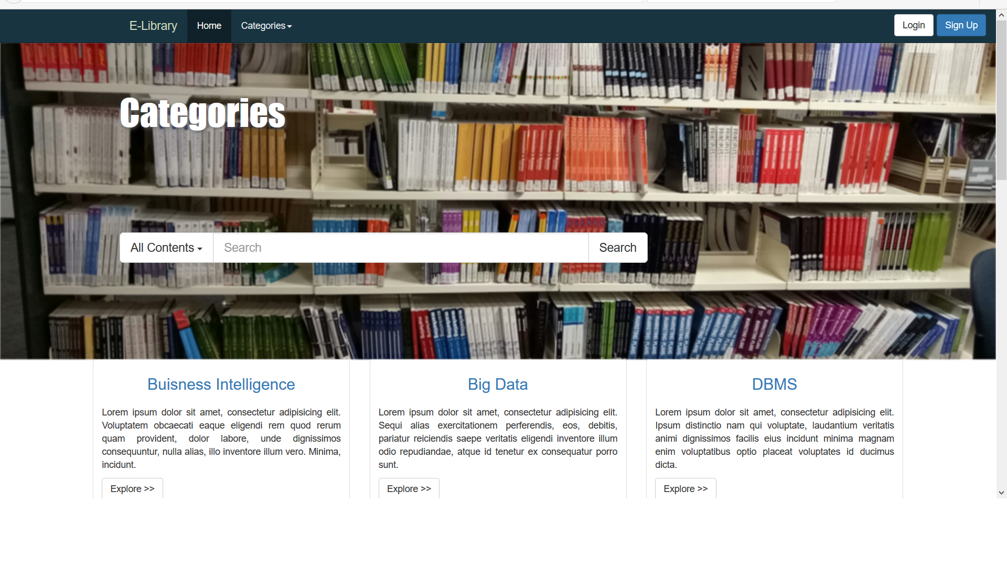
Global Category Page:

Slide 22
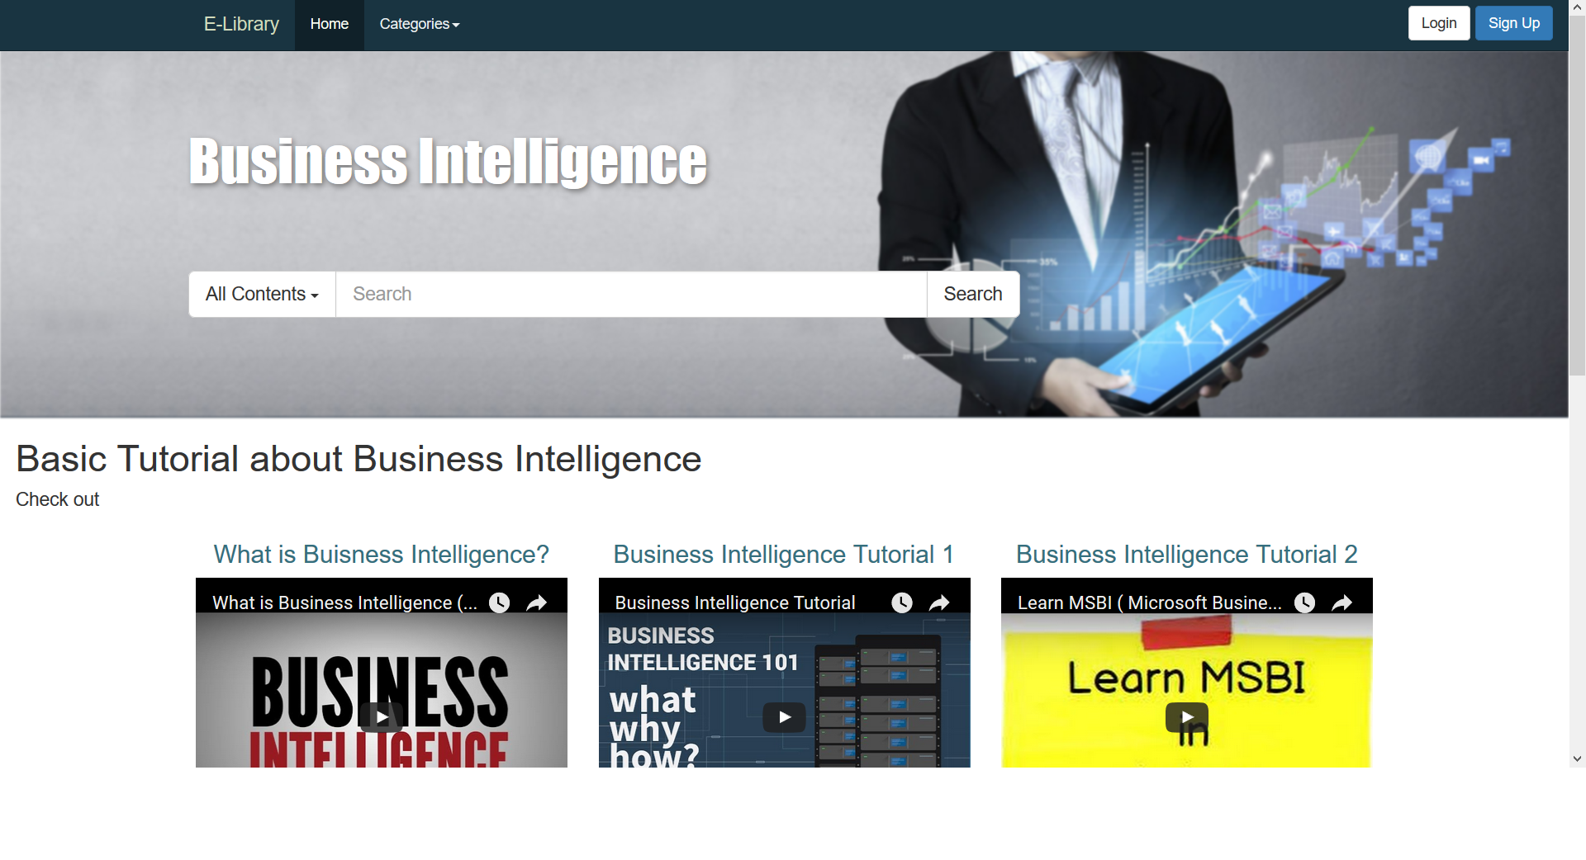
Tutorial: Business Intelligence

Slide 23
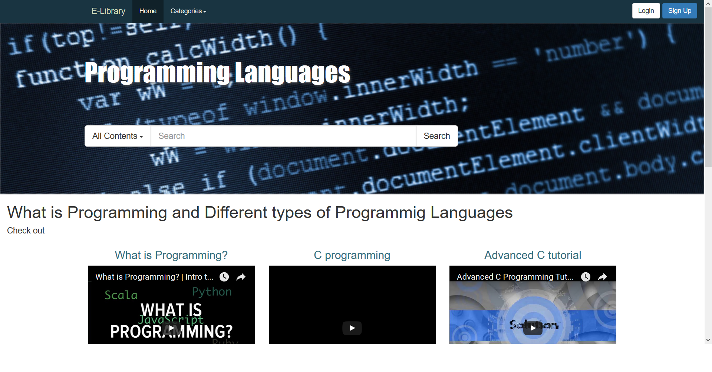
Tutorial : Programming Languages

Slide 24
Footers:
Site Map
Contact Us
About Us
Support
Help
Social Networking
Quick Links

Slide 25
Footers (Contd)

Slide 26
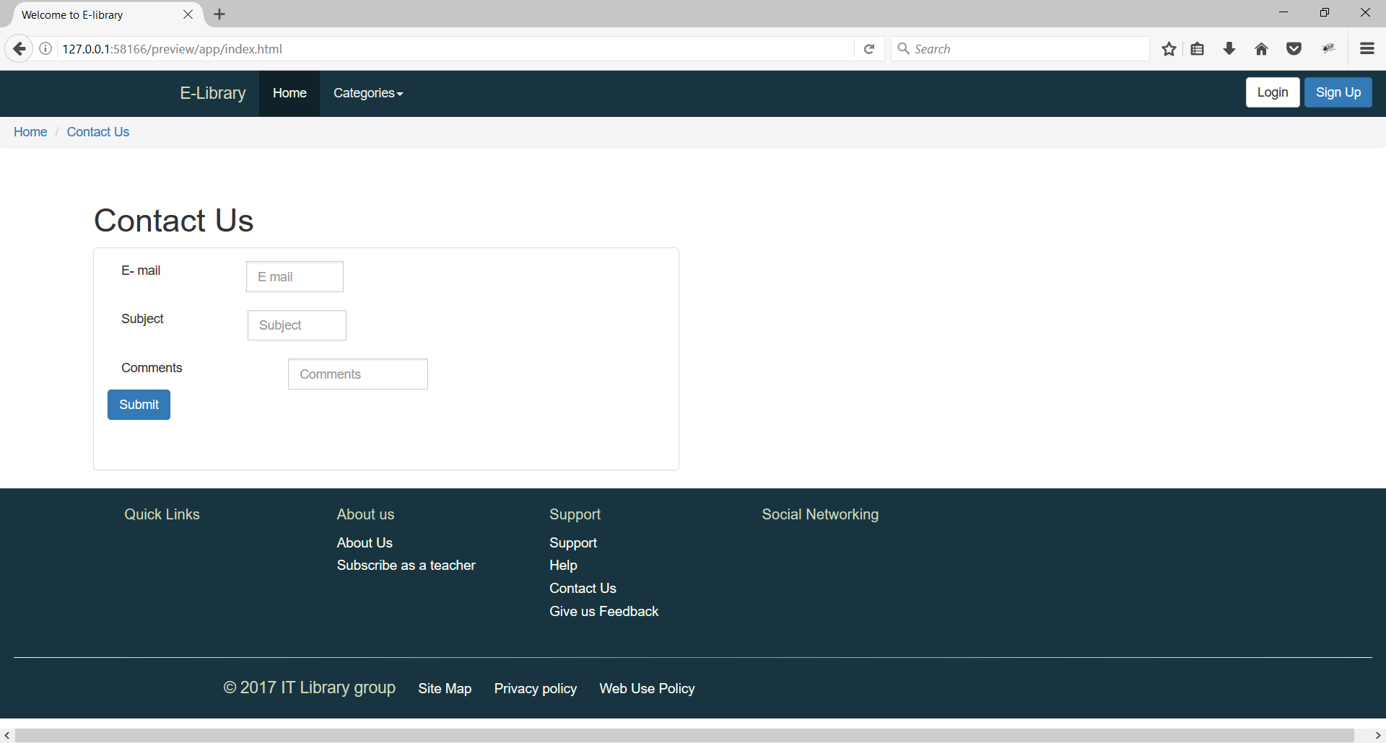
Contact us Form:

Slide 27
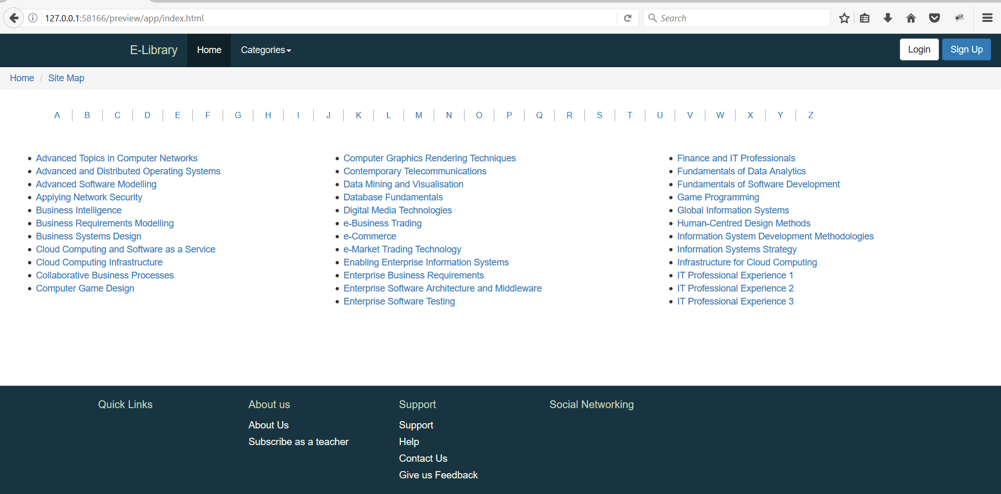
Site Map:

Slide 28
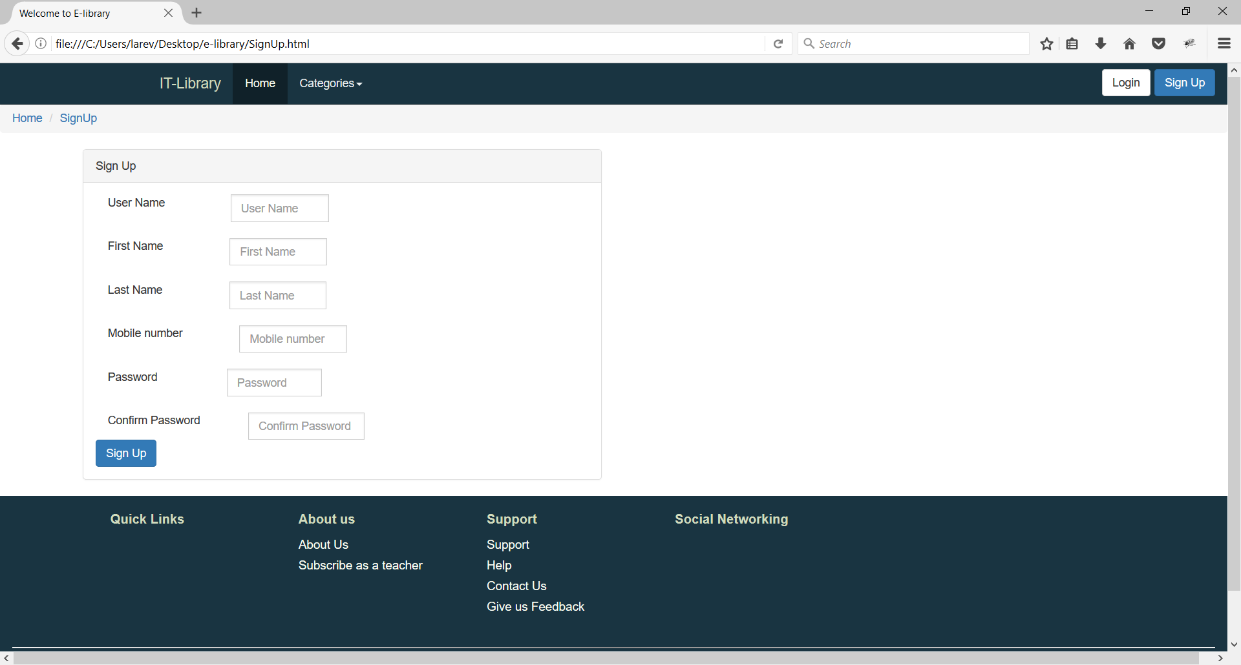
SIGN UP

Slide 29
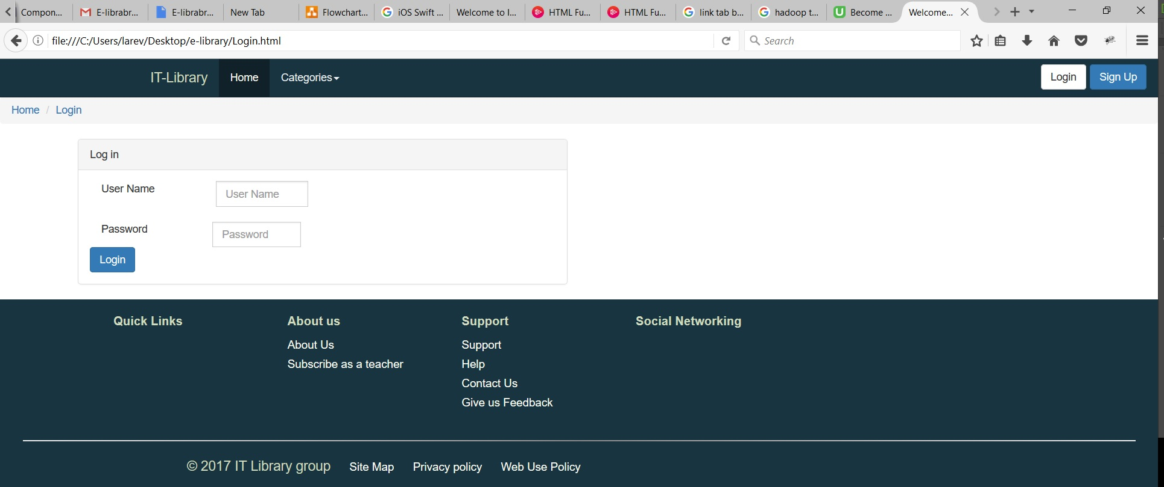
Log IN

Slide 30
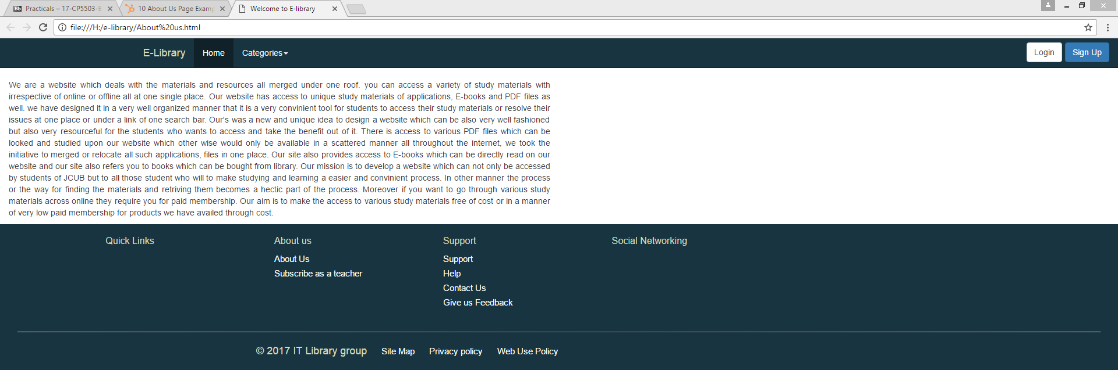
About us

Slide 31
Log In & Sign up
The log in and sign up at the webpage is placed in right corner at the navigation bar where you can click and access to the page.
If you don’t have access to username and password to you have go through a pathway from sign up where by completing the process it grants you the access to log in.

Slide 32
INFORMATION ENTERED
If you want to access to the log in you have to enter the username and password in the required bar
In case you haven’t created an account with us you have sign up for the account from the sign up link provided which directs you to the sign up page where you can enter all the fields in the Bar provided.

Slide 33
User information implementation
There are basically two types of user who will access our website
The first one will be the users who can access who can approach a limited number of materials on our website
The second class will be the sign up membership who can have the premium access to the website and can proceed to all the available materials on our website
Our website can you also refer you to the materials by providing link to the resources outside the website available online

Slide 34
Accessing the user accounts
While registering for the user accounts you need to provide all the fields asked for your user authentication
After the process for sign up you will be granted an account by virtue of which you can access the premium resources
For using the basic resources your user authentication and logging in is not necessary

Slide 35

THANK YOU & HAVE A GOOD DAY

